Slide 1

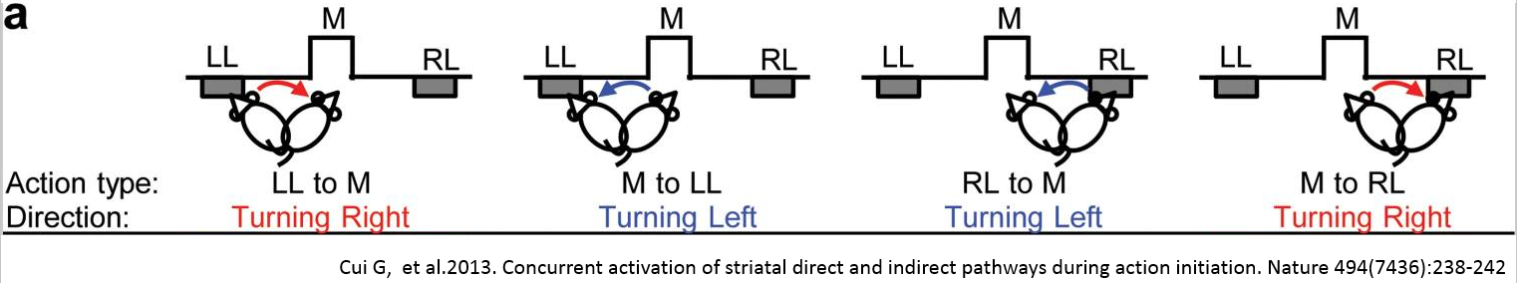
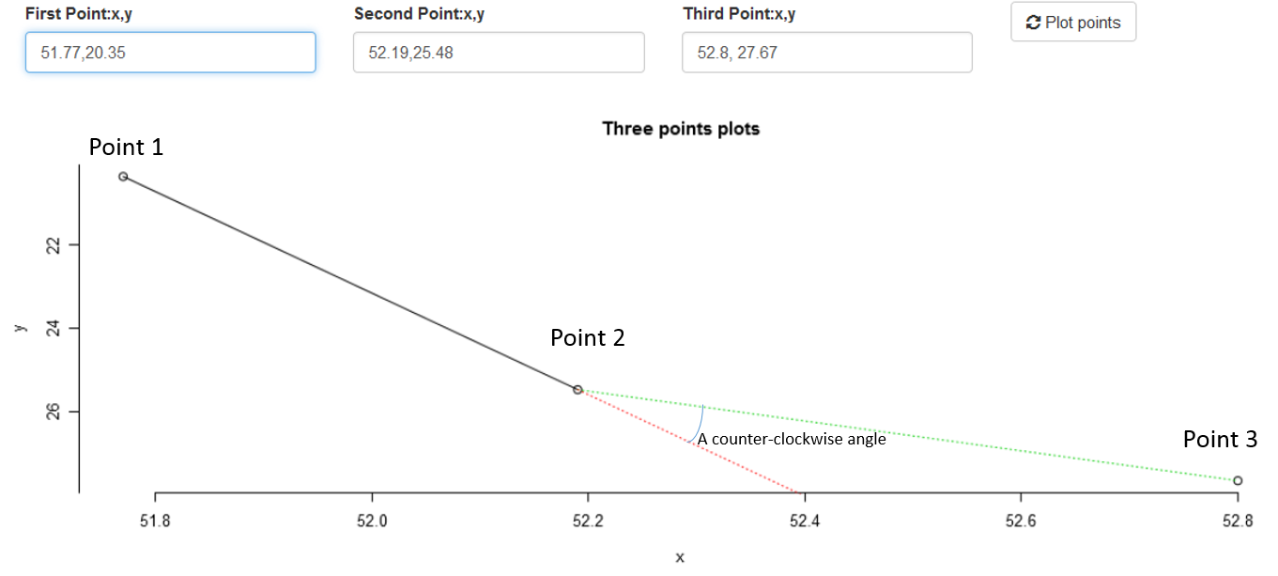
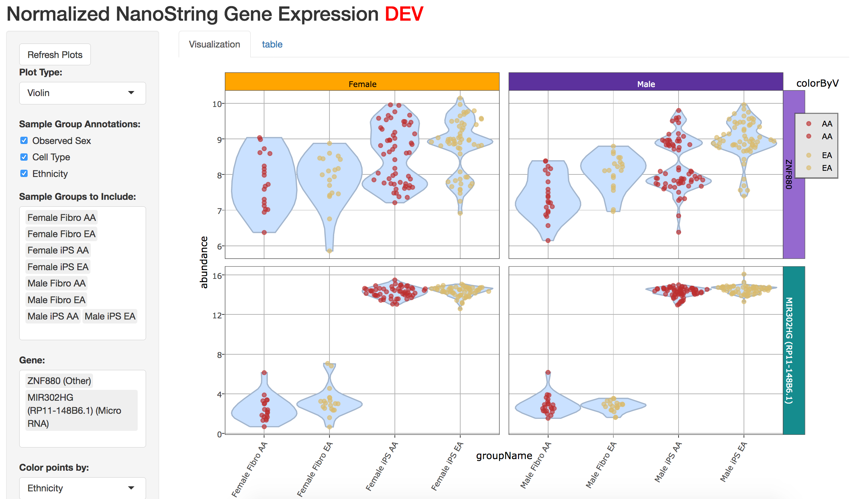
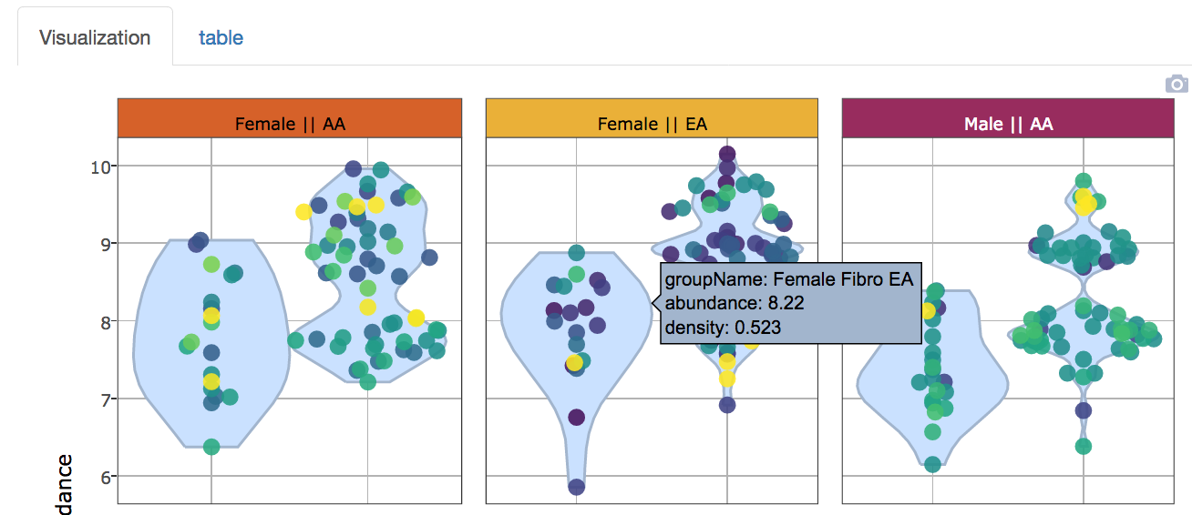
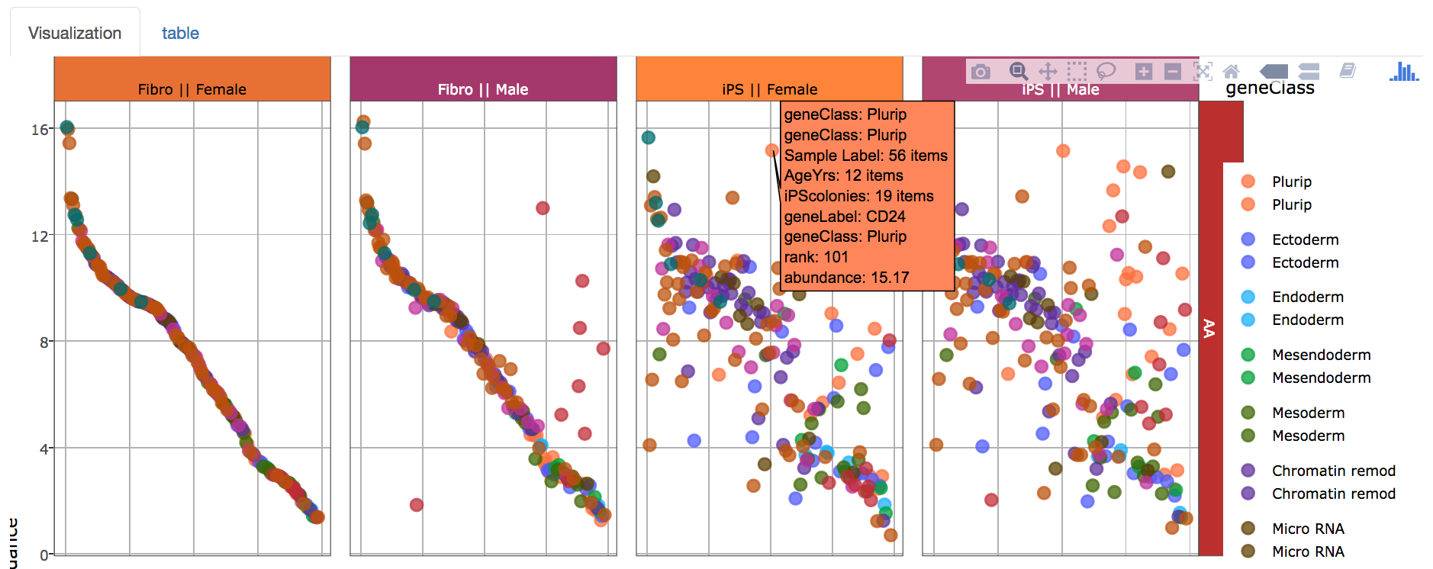
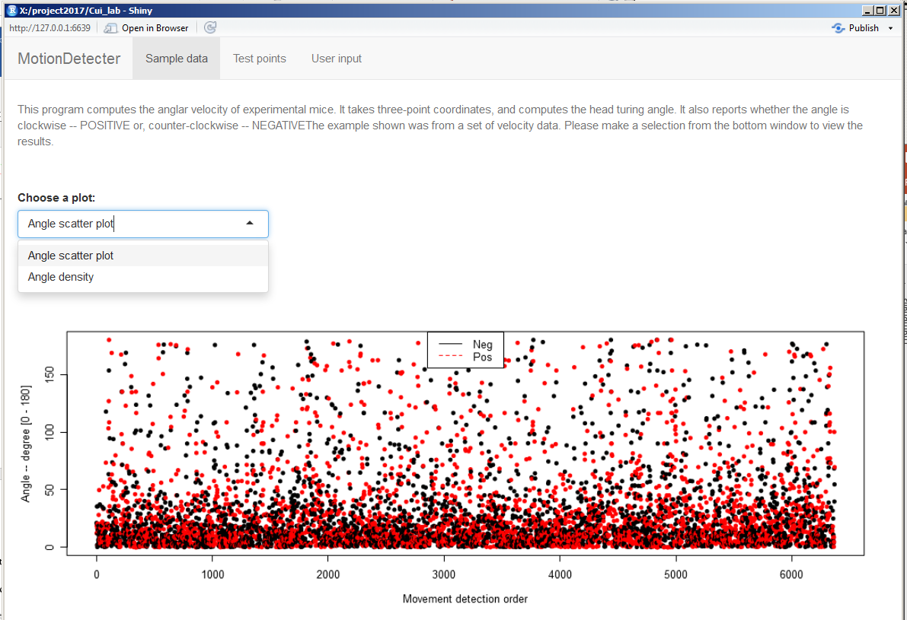
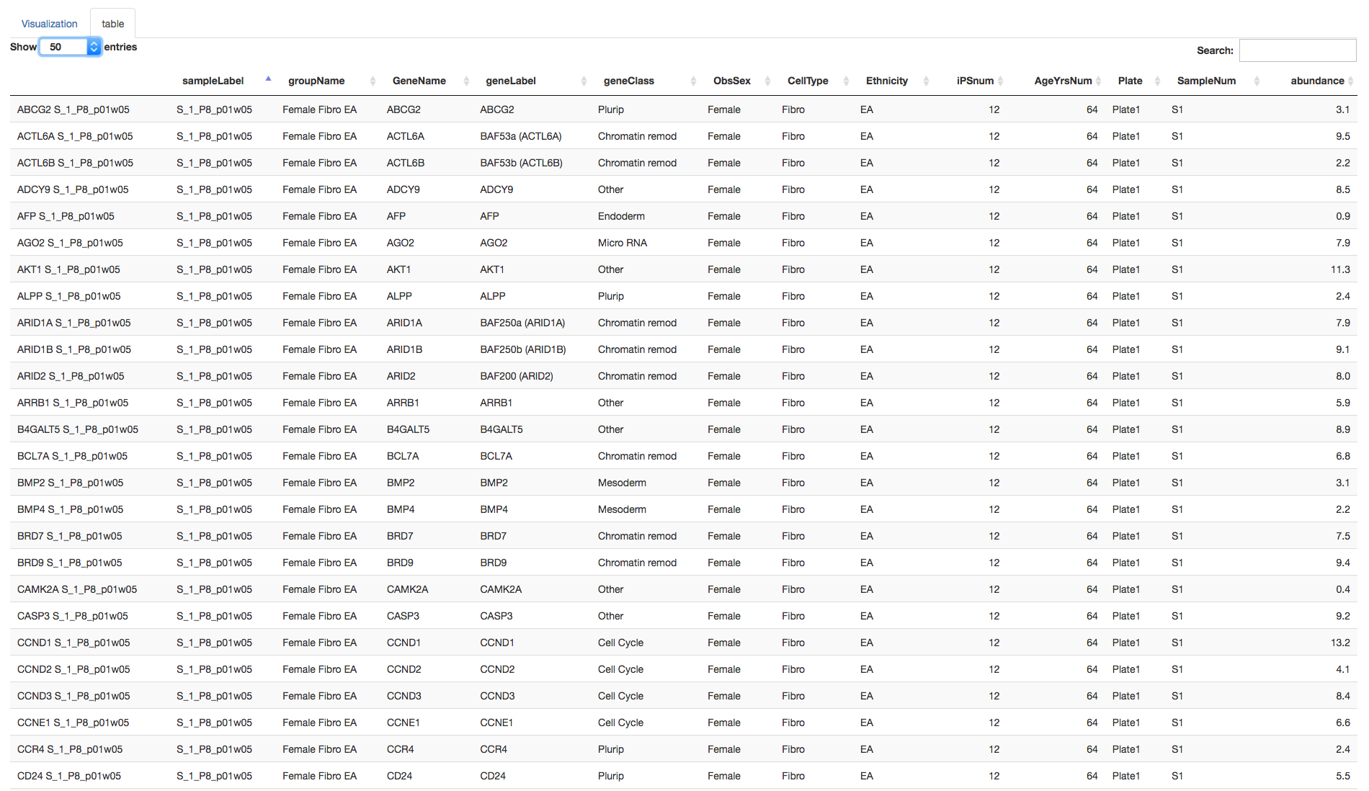
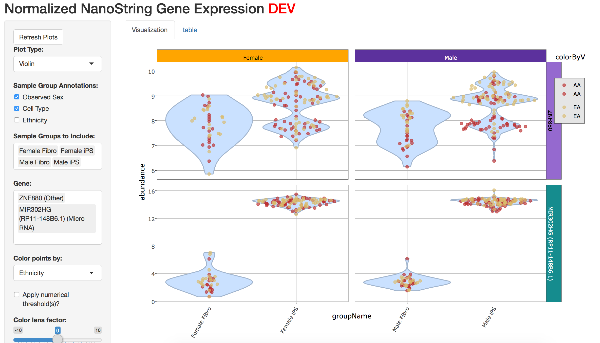
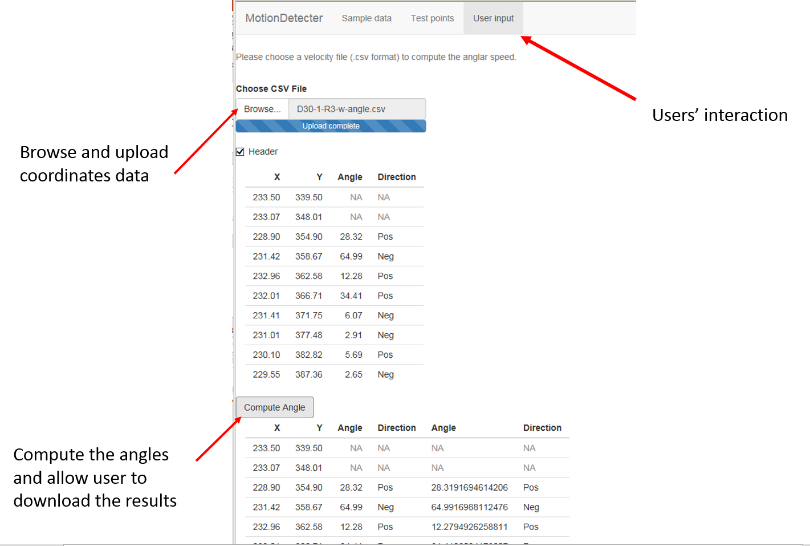
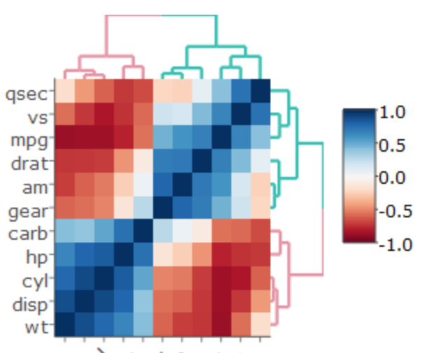
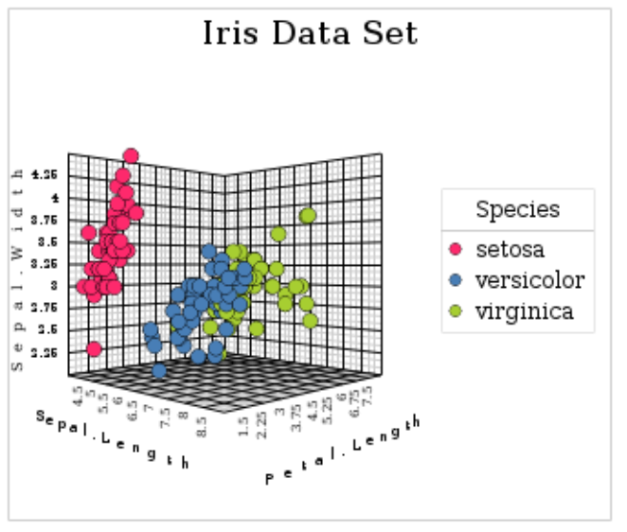
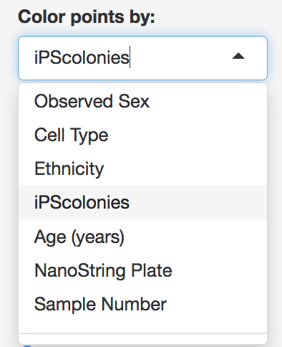
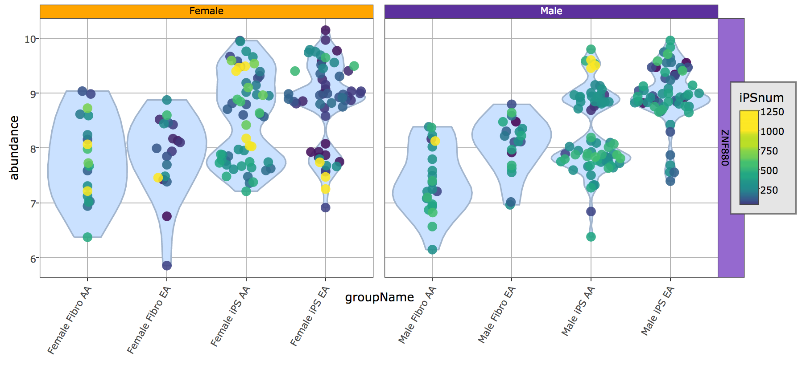
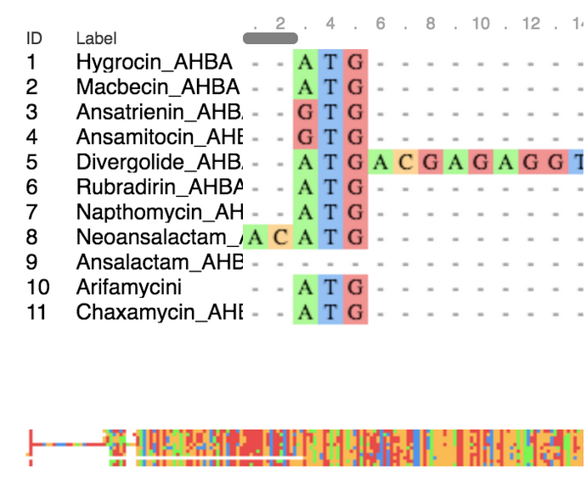
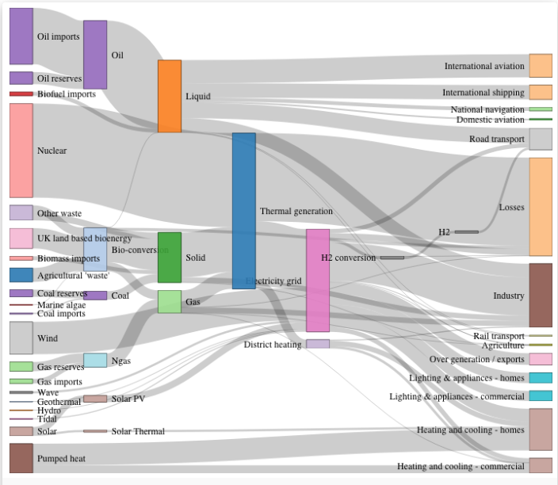
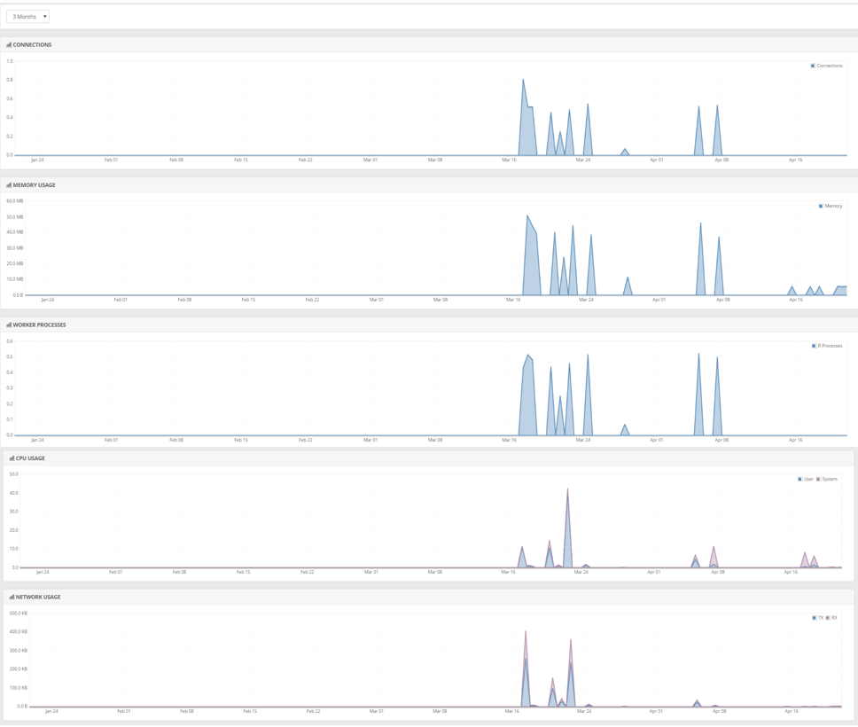
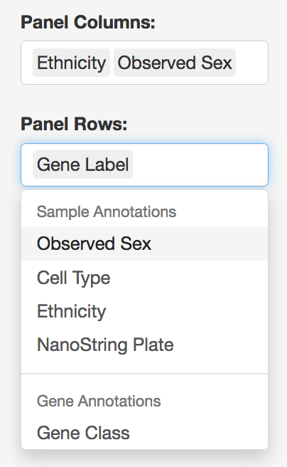
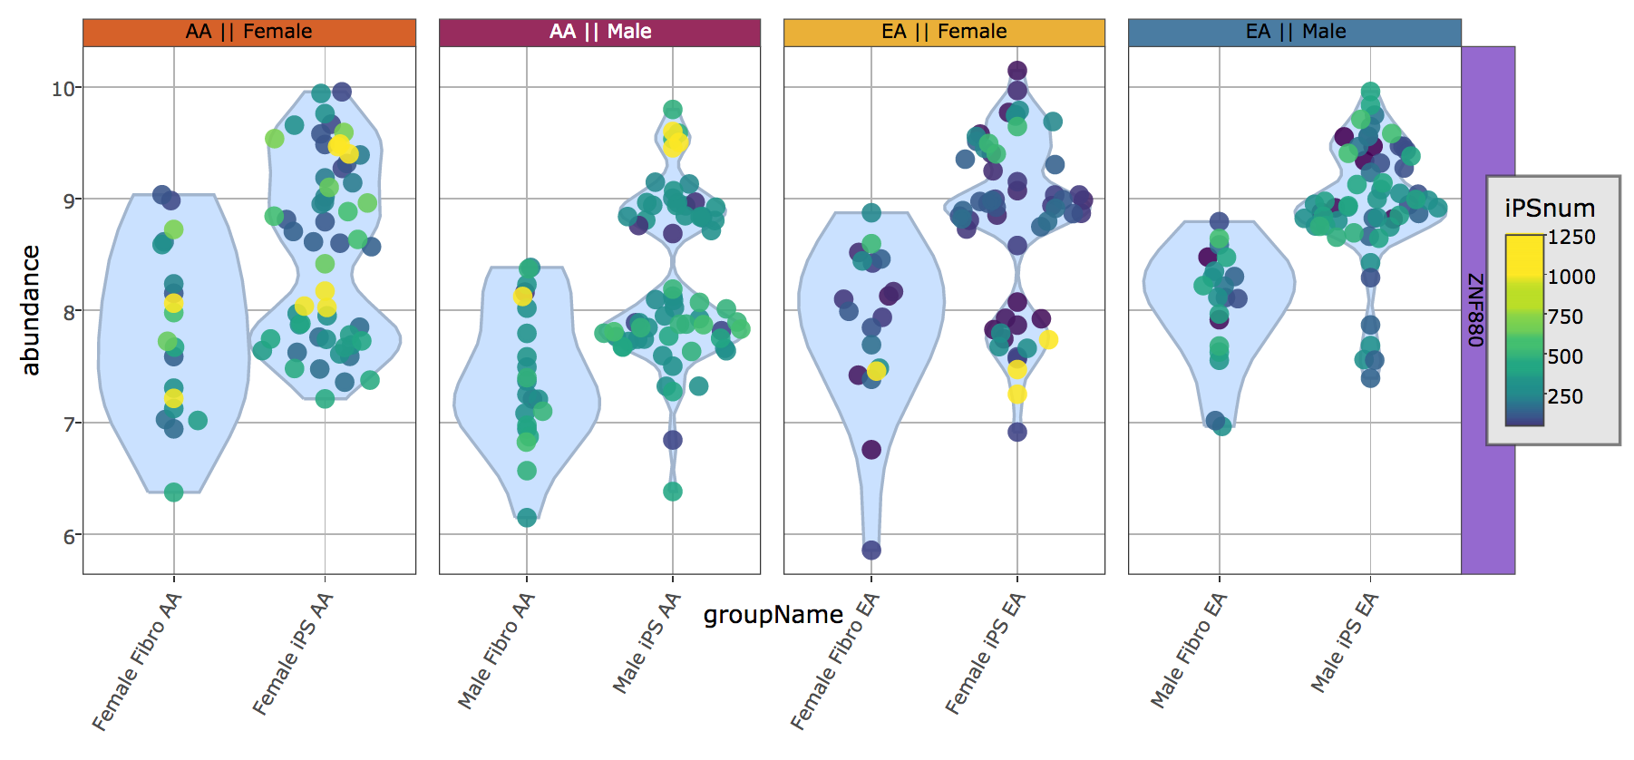
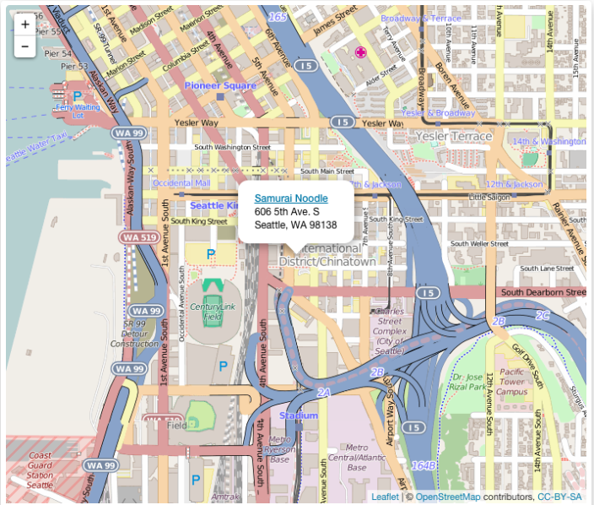
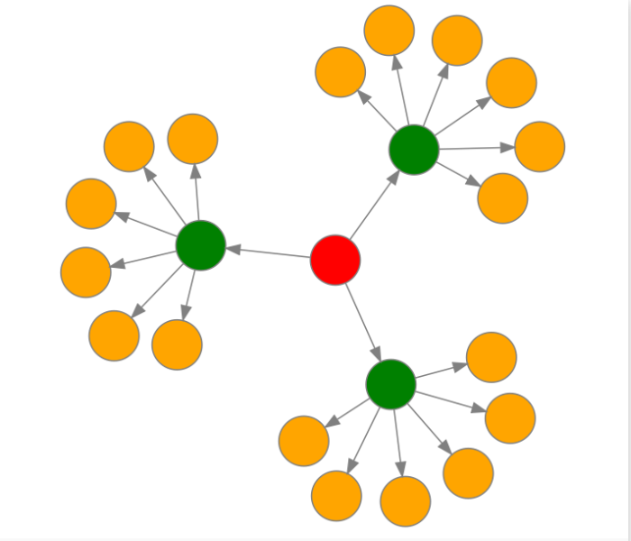
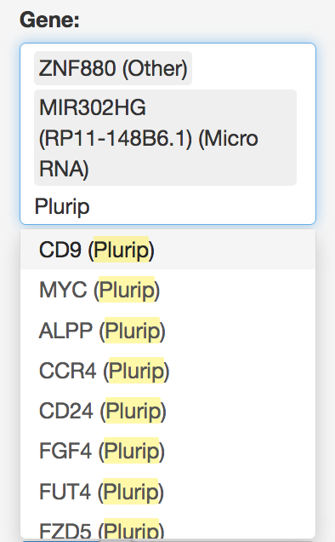

Bioinformatics advance: From static report to interactive data analysis
Jianying Li^{1,2}, James M. Ward^{1,2 1}Integrative Bioinformatics Group, ²Kelly Government Solutions, Inc.
Results
Abstract
Motion Detection app
NanoString Gene Expression
Summary
.
.
Recent advances in data visualization techniques have inspired the creation of numerous software libraries that enable interactive visualizations. We describe two projects that apply and extend the R-shiny framework to deliver data directly from our Bioinformatics analysis desktops to web-based tools intended for project scientists. These tools enable scientists to explore and analyze data with greater control of the output, with the ability to drill down into specific details too difficult to uncover using Excel, and impractical to include in static figures. While not a replacement for face-to-face meetings, the web tools allow investigators interactive control over visual and analytical parameters, not only to reproduce the principal statistical results, but also to evaluate their own hypotheses and analyses independently. Custom visualizations can be saved as high-quality figures, and the underlying data can be exported into Excel for further review.
We demonstrate one example of interactive visuals for a large NanoString gene expression study on ex vivo cell reprogramming. The visualization enables the dynamic definition of sample groups, the exploration of various sample attributes via colorized points and multiple plot panels, and the display of the gene expression distribution across sample groups. Another application “MotionDetection” enables Dr. Chengbo Meng in the in vivo neurobiology group to test animal motion and validate the computations of head moving angular velocity. The web portal also allows her to run bulk analyses for future experiments.
The R-shiny framework produces a fully functional web-application, manages the HTML, CSS, and JavaScript components, along with a growing number of R packages that hook into numerous other innovative visual software libraries. There is a vast and rapidly growing library of dynamic visual tools available, including enhanced scatter and line plots, Circos type genome plots, heat maps, world maps, and network diagrams, each with ability to link with other figures in real-time. Our intent is to utilize these interactive visualizations as a core part of our Bioinformatics workflow, to extend our analysis capabilities and empower scientists to achieve maximum value from their experimental results.
Rationale
At Cui lab, an in vivo fiber-optics based photometry method was developed to measure the fluorescent signals in a free moving mouse. Physical coordinates of mouse tail and head positions are used to determine the angular speed and direction of the mouse in different neurological states to study the mouse behavior.
Method
Based on any given three consecutive point coordinates of a mouse head’s positions, we first compute the distance between each pair of the two points; then use the cosine formula to find the angle between point1-point2 and point2-point3. A linear function was derived using the first two points and was further used to determine the direction (clockwise or counter-clockwise) of the third point in respect to the extended the line.
Rationale
The main objectives when evaluating data by different criteria are explained below.
Understand the character of the data
the distribution of signal response,
the variability of data measurements,
the responsiveness of different genes across the study.
ZNF880 measurements show fairly large variability within sample groups, and suggests a bimodal distribution of expression.
miR-302 host gene shows “on/off” expression, with fairly low variance within sample group.
Interactive Analysis
Many experiments lend themselves well to modifying the specific analytical approach, by changing analysis parameters on the fly based upon observing the characteristics of the data. These changes can assist with hypothesis generation, and may suggest avenues for more rigorous statistical tests to be performed offline. We suggest that many intuitive observations can be made without specific programming, simply by enabling more scientists to see their data in a flexible manner.
Interactive Visualization
Once a plot or figure has been produced, it is typically a static representation of data with little ability to drill down into its underlying details. We propose a standard analysis workflow where the end result contains a series of dynamic visualizations, with ability to drill down into specific data points as desired.
Hover Text can be defined to appear when a point is selected, or when a mouse pointer hovers above a data point or violin group summary, shown below.
Table Views, and Excel Export, are commonly used to allow detailed drill-down into the specific data being displayed, an example of which is shown below.
Figure 1. A illustration of mouse head movement detected in unit time
ZNF880
miR-302 host gene
Female
Male
ZNF880
Figure 2. An illustration of an angle formed by three consecutive points
miR-302 host gene
App main features
.
In this application design, a navigation page was used to host three parallel tabPanels. The first tabPanel provides a statics introduction about the application with a preloaded dataset and results. Users can explore features and view about 6000 angular results either from a scatter plot or density plot. The y-axis indicates the scaler angle and the color code indicates whether the angle was Negative (counter-clockwise) or Positive (clockwise). (Figure 3)
The second tabPanel allows the researcher to compute the angle from three consecutive point coordinates of a mouse head’s positions. This feature frees up manually measuring the angle on a sheet of graph paper, so that the researchers can test individual case (Figure 2).
The third tabPanel allows the researchers to upload new dataset and compute the results freely. The results can be downloaded and used in further analysis. (Figure 4)
Group samples by different sample attributes:
One may remove “Ethnicity” from the sample grouping, to aggregate gene expression without this factor. It might increase statistical power, in the event that Ethnicity is not a distinguishing phenotype for this dataset.
Interactive Visualizations in R
The R-shiny workflow has catalyzed the development of numerous interactive visualization packages available to R statistical programmers. The examples below represent the varied types of plots possible, which we expect to enable many new types of interactive figures.
Figure 3. A static tabPanel page of preload data
Female
Male
heatmaply canvasXpress
ZNF880
Modify plot features interactively
Several features can be changed, which may help visualize otherwise subtle changes in the data across the experiment.
Data point color – categorical coloring, or continuous color using a numerical scale
Plot panels (facets) – plots can be split into panels, and optionally organized into columns and rows using categorical sample attributes.
Specify sample groups and genes
Focus on selected genes and sample groups
Search by substring, gene classification
Figure 4. User interaction through a tabPanel
References
.
msaR d3network
App administration
Cora, M. C., D. King, et al. (2012). "Artifactual changes in Sprague-Dawley rat hematologic parameters after storage of samples at 3 degrees C and 21 degrees C." Journal of the American Association for Laboratory Animal Science : JAALAS 51(5): 616-621.
Cui G, Jun SB, Jin X, Pham MD, Vogel SS, Lovinger DM, Costa RM. 2013. Concurrent activation of striatal direct and indirect pathways during action initiation. Nature 494(7436):238-242
Farnan, L., A. Ivanova, et al. (2014). "Linear mixed effects models under inequality constraints with applications." PloS one 9(1): e84778.
Nelson, JW, Sklenar J, Barnes AP, Minnier J. (2016) “The START App: A Web-Based RNAseq Analysis and Visualization Resource.” Bioinformatics. doi: 10.1093/bioinformatics/btw624.
Jianying Li and Casey M. Jelsema (2015) Rshiny: Building an interactive web-application with R shiny package NIEHS Bioinformatics E-Bulletin
Shiny by RStudio: https://shiny.rstudio.com/
htmlwidgets for R: http://gallery.htmlwidgets.org/
The MotionDetection application is hosted on shinyapps.io, a public domain that hosts the shinyapps It provides full-length of administration capability to handle update and monitor usage over time. The project with Cui lab was initiation in early March and the application was deployed on March 17th.
leaflet DiagrammeR
Figure 5. An administration feature to monitor the usage and computational resource consumed

